Slide 1
Investigating Covariate Effects on BDD Infection with Longitudinal Data
Geoff Jones, Daan Vinke, Wes Johnson

Slide 2
Bovine Digital Dermatitis (BDD)
First described in 1974
Prevalent in Holstein-Friesian dairy cows
Often results in painful lesions and lameness
Major welfare concern
Clinical inspection is only recognized diagnosis
Lesions may or may not be prominent
New ELISA for Treponema spp. – more convenient
Infection vs Disease?
Temporal and Covariate Effects?

Slide 3
Foot Inspection

Slide 4
Data from Longitudinal Study
1548 obs^{n}s on 119 cows in 6 man. groups on 4 farms
Variables:
  Lesion Status (0/1)
  Serology Score (log₁₀PP)
  Foot Hygiene Score (per foot; 1=“v. clean” to 4=“v. dirty”)
  Age in years
  Testing date
Random effects:
  Cow
  FGT (farm group time)

Slide 5
Univariate Models – Lesion Status
Generalized linear mixed model fit by the Laplace approximation
Formula: L ~ Sin + Cos + xc + zc + zc2 + (1 | Cow) + (1 | FGT)
Random effects:
Groups Name Variance Std.Dev.
FGT (Intercept) 0.58315 0.76364
Cow (Intercept) 14.17329 3.76474
Number of obs: 1548, groups: FGT, 170; Cow, 119
Fixed effects:
Estimate Std. Error z value Pr(>|z|)
(Intercept) -0.77583 0.46081 -1.684 0.092253 .
Sin -0.44667 0.18237 -2.449 0.014316 *
Cos 0.56601 0.20351 2.781 0.005415 **
xc 3.22786 0.65919 4.897 9.75e-07 ***
zc 0.56784 0.17444 3.255 0.001133 **
zc2 -0.16668 0.04659 -3.578 0.000346 ***

Slide 6
Univariate Models – Serology Score
Linear mixed model fit by REML
Formula: S ~ Sin + Cos + xc + zc + zc2 + (1 | Cow) + (1 | FGT)
Random effects:
Groups Name Variance Std.Dev.
FGT (Intercept) 0.0012949 0.035985
Cow (Intercept) 0.0479153 0.218896
Residual 0.0169654 0.130251
Fixed effects:
Estimate Std. Error t value
(Intercept) 1.578070 0.023709 66.56
Sin 0.005323 0.006975 0.76
Cos -0.003778 0.007669 -0.49
xc 0.065007 0.019829 3.28
zc 0.065360 0.006650 9.83
zc2 -0.014888 0.001747 -8.52

Slide 7
Joint Modelling of Lesions and Serology
Seasonality
L_{t}
I_{t-1}
I_{t}
FGT Goup
Age
FHS
S_{t}
Cow

Slide 8
The Full Model
τ_{U}
sb₁
sb₂
Sin_{t}
sb₃
Cos_{t}
Sp
Se_{t}
U_{t}
q_{t}
L_{t}
I_{t-1}
p_{t}
I_{t}
a₂
S_{t}
V_{t}
a₁
b₂
xc_{t}
b₃
zc_{t}
b₄
μ₁
τ₁
μ₂
τ₂
τ_{V}

Slide 9
Posterior Densities of Model Parameters

Slide 10
Estimates of Model Parameters

Slide 11
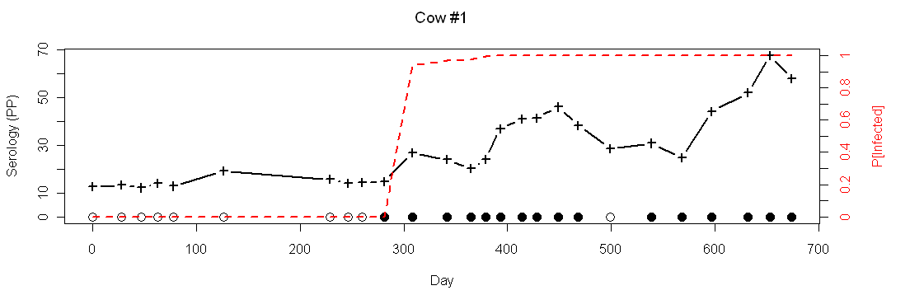
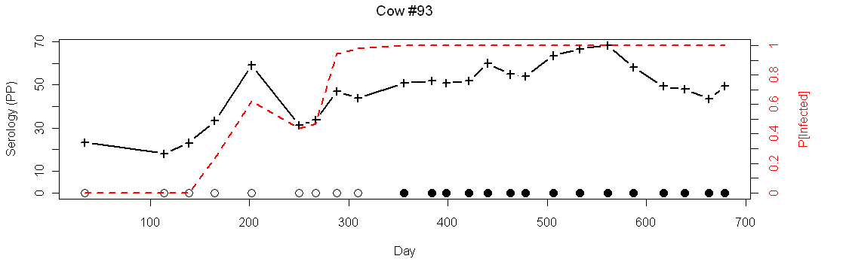
Predicted Infection Histories

Slide 12
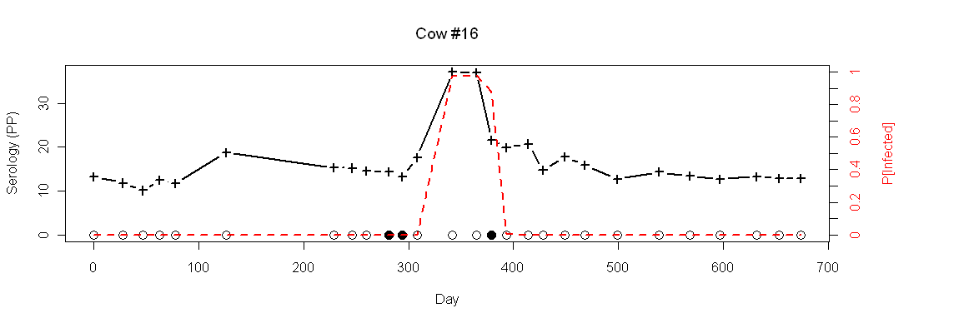
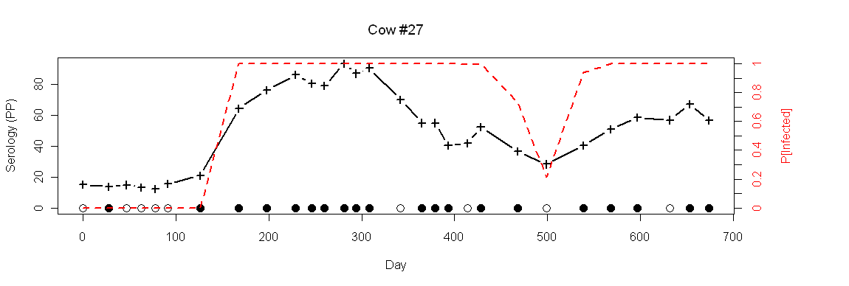
Predicted Infection Histories

